Slide 1
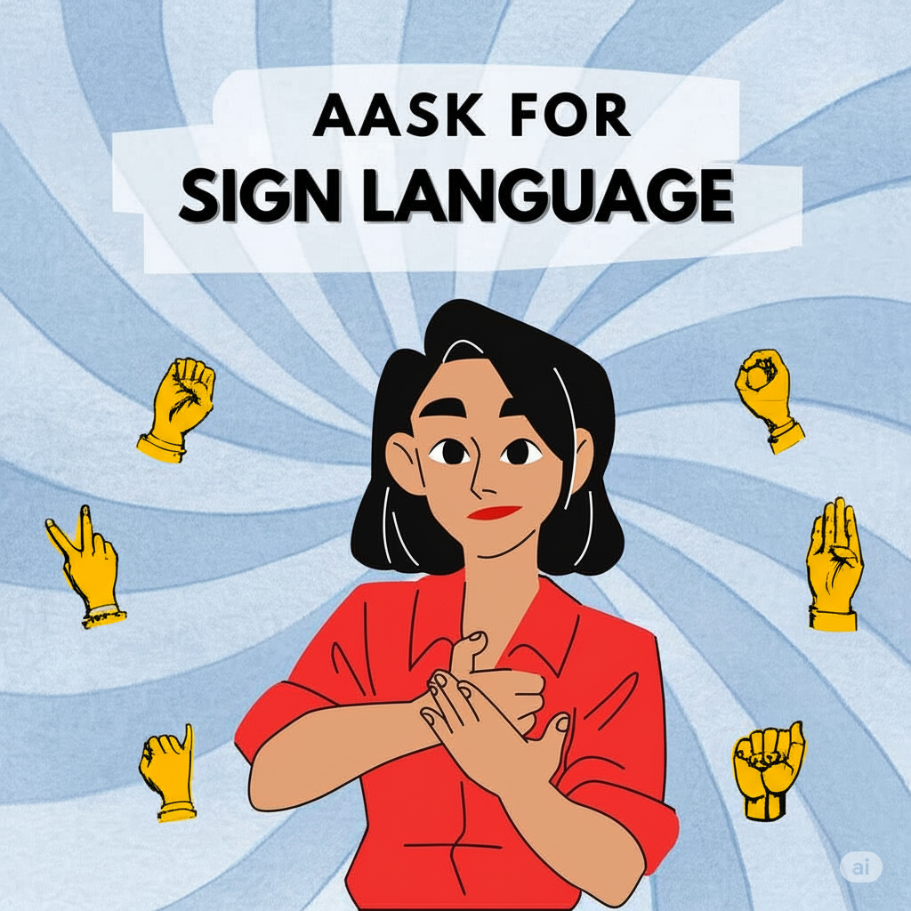
ASL APPLICATION
PRESENTED BY :- AVISHKAR KARCHE (B1411032) AVADHOOT KAMBLE (B1411029) KRUPA MARU (B1411042) SUMEDH KEDARI (B1411034)

Slide 2
Overview
Introduction
Problem Statement
Motivation
Scope
Objectives
Feasibility
Literature Survey
Model Architecture
S/w used
H/w required
Proposed system
UML Diagram
Detailed Working design
Dataset and training
Validation and testing
Output
Conclusion

Slide 3
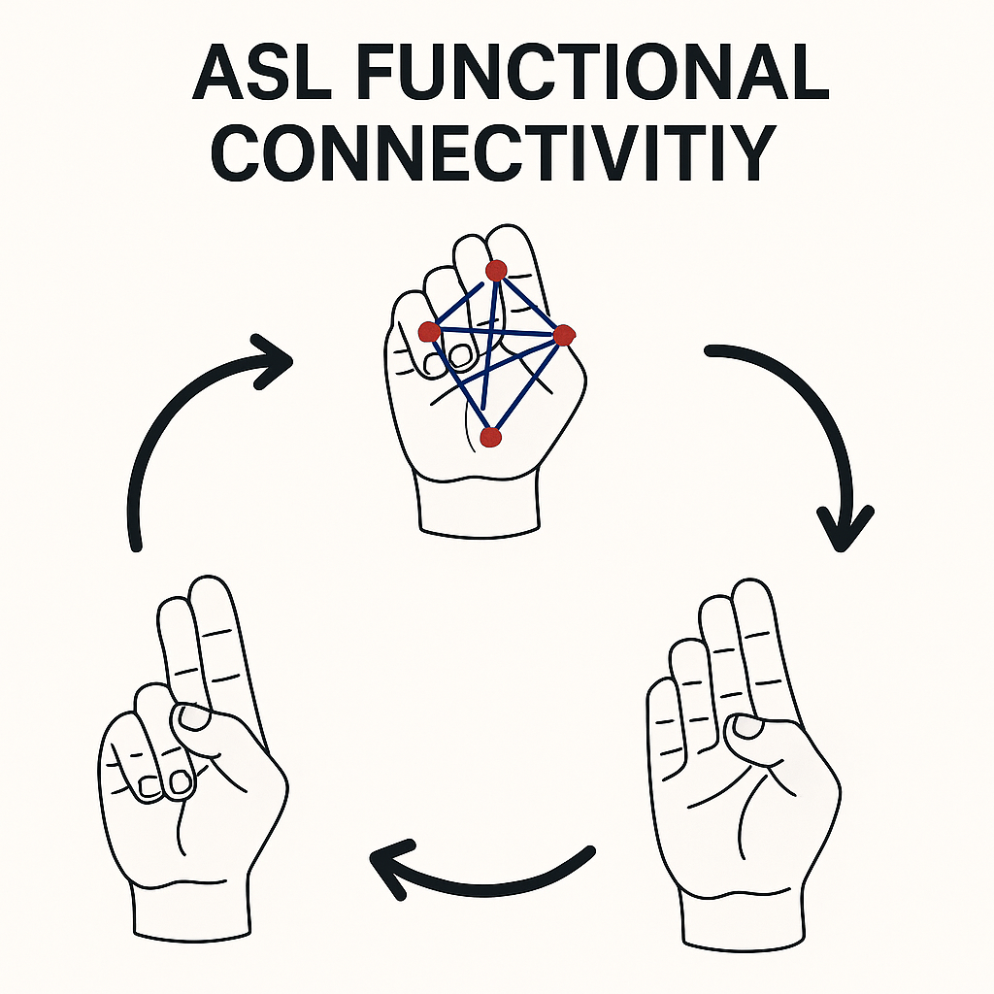
INTRODUCTION

Slide 4
INTRODUCTION
Deaf and hard-of-hearing individuals face major communication barriers that limit their participation in key areas like education, employment, and healthcare. Existing tools such as interpreters and closed captioning are often costly, inflexible, and not widely available. This project proposes a real-time, AI-powered American Sign Language (ASL) recognition system to translate gestures into text or speech, enabling seamless communication and promoting greater social inclusion and accessibility for the deaf and hard-of-hearing community.

Slide 5
PROBLEM STATEMENT
Design and create an AI-driven parenting system that employs Generative models and LLM Models to offer the text and audio output to bridge the between the deaf/hard of hearing people and normal people.

Slide 6
Motivation
Deaf and hard-of-hearing individuals face significant communication challenges in daily life.
Current solutions like interpreters and closed captioning are often costly, limited, or not available in real-time.
These barriers restrict access to education, employment, healthcare, and social inclusion.
The project aims to leverage artificial intelligence to build an accurate, real-time ASL recognition system.
The goal is to improve accessibility, enable smoother communication, and promote equal opportunities for the deaf and hard-of-hearing community.

Slide 7
SCOPE
Web Application Development
Gestures-Text-Speech Conversion
Enhancing Model Accuracy
Multilingual Translation
User Experience Improvements

Slide 8
OBEJCTIVES
Develop an AI system to translate American Sign Language (ASL) gestures into text or speech.
Ensure real-time recognition with high accuracy for seamless communication.

Slide 9
FEASIBILITY
AI/ML Maturity: Significant progress in deep learning, computer vision provides a strong foundation. Techniques like convolutional neural networks (CNNs) for gesture recognition and recurrent neural networks (RNNs) or YOLO are well-established.
Hardware Capabilities: Modern GPUs and specialized AI accelerators can handle the computational demands of real-time gesture recognition and processing.
Existing Datasets (Potential): While specific ASL datasets for real-time translation might be limited, research and development in sign language recognition are ongoing.
Frameworks & Libraries: Robust open-source AI frameworks (e.g., TensorFlow, PyTorch) and libraries provide the necessary tools for rapid prototyping and development.

Slide 10
FEASIBILITY
Skillset Availability: The required expertise in AI/ML, computer vision, NLP, and software development is readily available within the tech industry and academic institutions.
Integration: The project can likely integrate with existing web application development practices and tools for user interface and deployment.
User Experience: While challenging, improving user experience is a known area of focus in software development and can be addressed through iterative design and testing.
Cost of Development: Initial development costs will primarily involve personnel (AI engineers, data scientists, software developers) and computational resources.

Slide 11
LITERATURE SURVEY
This involved an in-depth review of academic papers, industry reports, and open-source projects related to real-time sign language recognition, computer vision for gesture interpretation, natural language processing for text and speech generation, and human-computer interaction in assistive technologies. The survey aimed to identify current state-of-the-art methodologies, prevailing challenges, and potential solutions, thereby informing our approach to developing a robust and accurate American Sign Language translation system.

Slide 12
Sr. No. | Paper Title | Author Details | Objectives | Methodology | Parameters Used | Accura cy | Result/ Remark s
1 | American Sign Language Recognition System: An Optimal Approach | Shiva shankara S, Srinath S | To improve ASL recognition accuracy using new techniques | Proposed a system using various image processing techniques like grayscale conversion, binary conversion, erosion, dilation, and median filtering | Image processing parameters: grayscale conversion, binary conversion, erosion, dilation, median filtering | 95% for ASL numbers , 93.05% For ASL alphabet s | Non- occluded gestures show better recognition accuracy compared to occluded gestures
2 | Handshapes and Movements: Multiple- Channel American Sign Language Recognition | Christian Vogler and Dimitris Metaxas | To validate the choice of handshape features and the modelling of independent channels in ASL recognition | Used parallel Hidden Markov Models (PaHMMs) to handle independent channels, including handshape and movement | Features: joint angles, measures of finger openness, width and height of quadrilateral described by a finger | 99.47% For handshape recognition, 93.27%, Word accuracy for right- Hand movement channel | Quadrilateral-based handshape representation is more robust than raw joint angles, independent channel modelling shows promising results

Slide 13
3 | Real Time Hand Gesture Recognition Using Different Algorithms | Md. Islam, Angur Jarman, Samiul Arshad, Nashid Alam, and Mohammed J. Islam | To develop a robust hand gesture recognition system for American Sign Language (ASL) alphabets and numbers | Image acquisition, preprocessing, feature extraction (fingertip detection, eccentricity, elongatedness, pixel segmentation), feature recognition using ANN | Fingertip detection (K convex hull) - Eccentricity - Elongatedness Pixel segmentation | 94.32% | The proposed system shows superior performance in terms of accuracy and recognized classes compared to existing methods
4 | A Simple Multi- Modality Transfer Learning Baseline for Sign Language Translation | Yutong Chen, Fangyun Wei, Xiao Sun,Zhirong Wu, Stephen Lin | Propose a simple transfer learning baseline for sign language translation. | Progressively pretrain the Model from general-domain datasets to within-domain datasets, Including a visual-language mapper for joint training. | Visual encoder, gloss-to-text translation network, visual- language mapper. | Not explicitly mention ed. | Surpasses previous state-of- the-art results on two sign language translation benchmark s.
5 | American Sign Language Recognition using Deep Learning and Computer Vision | Kshitij Bantupalli, Ying Xie, Department of Computer Science, Kennesaw State University | Create a vision- based application for sign language translation to Text aiding communication between signers and non-signers. | Ensemble of CNN (Inception) and RNN(LSTM) models to extract spatial and Temporal features from video sequences. | Batch size: 64, Epochs: 10, Cross-entropy loss function, ADAM optimizer | CNN Softmax Layer: 90%- 93%, Pool Layer: 55%- 58% | The model performed well on training data but faltered with diverse skin tones and clothing. Future improvements include using Capsule Networks and exploring different RNN architectures.

Slide 14


MODEL ARCHITECHTURE

Slide 15
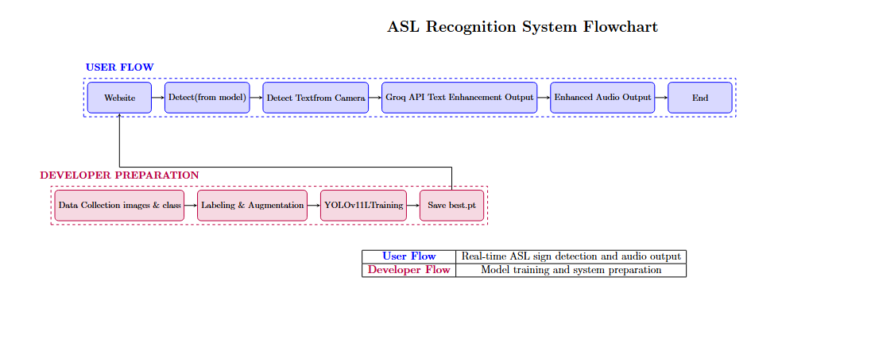

Slide 16
SOFTWARE REQUIREMENTS
Operating System (e.g.:- Windows, macOS, Linux)
Development Environment (e.g. :-WSL, VS CODE,CUDA).
GROQ API
Framework Flask,YOLOV11
HTML,CSS,JS,OPEN CV

Slide 17
HARDWARE REQUIREMENTS
Minimum RAM requirement (e.g., 24GB RAM recommended).
Processor specifications (e.g., Intel Core i5 or AMD Ryzen 5).
Computer or Laptop with internet access.
High resolution Camera
Graphics Processing Units (GPUs)

Slide 18
PROPOSED SYSTEM
User Interface
AI Content Generation
Adaptive Algorithms

Slide 19
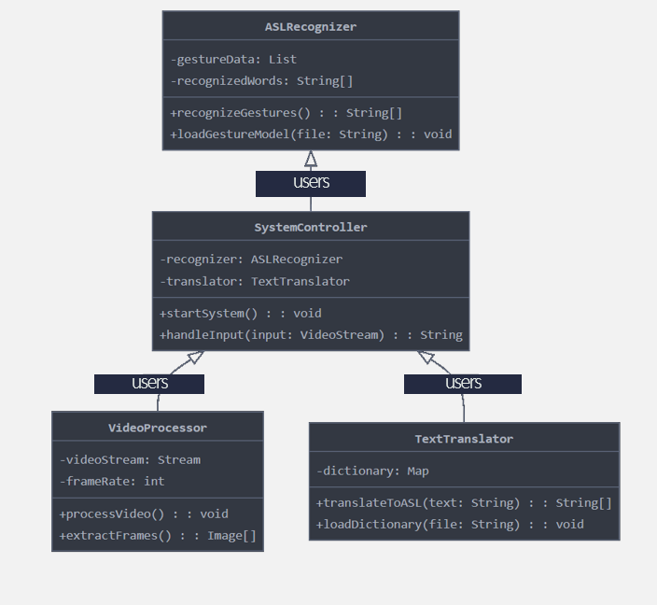
UML DIAGRAM

Slide 20
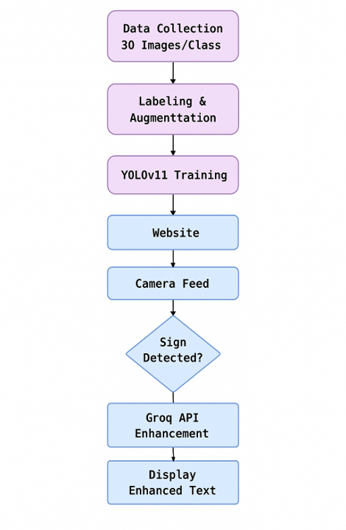
DETAILED WORKING DESIGN

Slide 21
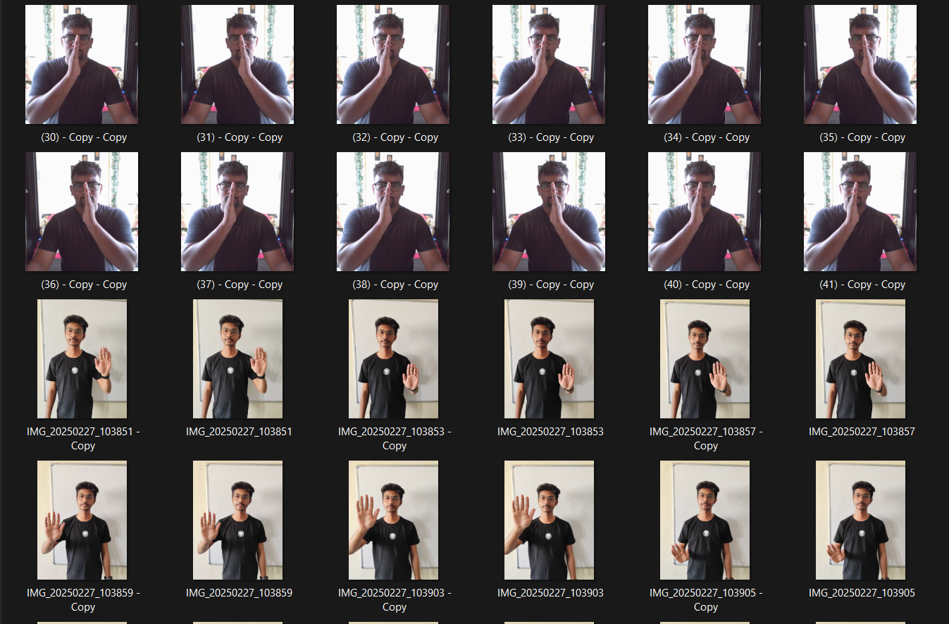
DATASET & MODEL TRAINING

Slide 22
Step1:- Data Collection for YOLOv11
This is where model truly learns! The quality and diversity of images directly impact how well YOLOv11 model performs.
Quantity & Diversity are Key:
Start with 30+ images per class, but aim for hundreds or thousands for robust real-world performance.
Capture images with wide variations:
Lighting: Bright sun, shadows, indoor, low light.
Backgrounds: Cluttered, plain, different textures.
Angles & Perspectives: Front, back, sides, top, close-up, far away.
Occlusion: Objects partially blocked.
Scale: Objects at different sizes within the frame.
Mimic Real-World Conditions: Collect data under the same conditions your model will operate in (e.g., if it's for outdoor surveillance, use outdoor footage).

Slide 23
Step2:- Image Labeling with makesense.ai (YOLO Format)
Accurate and consistent labeling teaches model precisely what to detect.
Tool: Use makesense.ai (free, web-based) for efficient annotation.
Process: Upload Images: Get your collected images onto the platform.
Define Labels: Create clear names for each class (e.g., "A", "B", "C" for ASL). The order defines their class_id (0, 1, 2...).
Draw Tight Bounding Boxes: Draw a box tightly around every instance of your object in an image.
Maintain consistency across all labels (e.g., how to handle partial occlusion).
Export in YOLO Format: This creates a .txt file for each image.
Each line in the .txt file represents one object: class_id x_center y_center width height
All values (except class_id) are normalized (between 0 and 1) based on image dimensions.
Output Structure: Your final dataset should look like this, ready for training:
dataset/
├── images/
├── image1.jpg
└── ...
└──
labels/
├── image1.txt
└── ...

Slide 24
Step 3: Data Augmentation
Data augmentation artificially expands dataset, making your YOLOv11 model more robust and preventing overfitting, especially with smaller datasets or class imbalances.
Why Augment?
Increase Model Robustness: Teaches the model to recognize objects despite variations.
Handle Small Datasets: Creates more training examples from existing ones.
Address Class Imbalance: Generate more samples for underrepresented classes.
Common Techniques:
Geometric: Rotation, Flipping (horizontal/vertical), Scaling, Cropping/Zoom.
Photometric: Brightness, Contrast, Saturation adjustment, Noise injection.
Tools:
Libraries like Albumentations or OpenCV.
Often, YOLO training frameworks (like Ultralytics YOLO) have built-in augmentation capabilities.

Slide 25
Step 4: Model Training with YOLOv11
This is where model learns to detect custom objects using the annotated data.
YOLOv11 Note: Acknowledge YOLOv11 as likely a community/custom version building on strong YOLO foundations (e.g., YOLOv8/v5).
The training workflow is generally consistent.
Key Training Steps:
Environment Setup:
Install PyTorch.
Clone the YOLOv11 repository (or relevant Ultralytics YOLO version).
Install dependencies.
Dataset Organization: Structure your data into train and val sets.
Create data.yaml Config: Tell YOLO about your dataset.
Run Training Command: Start the training process (example for Ultralytics-style)

Slide 26
Step 5: Model Evaluation
After training, it's crucial to assess YOLOv11 model's performance to understand its effectiveness. Purpose: Quantify how well your model detects objects. Identify areas for improvement (e.g., more data, different hyper-parameters). Key Metrics: mAP (mean Average Precision): The primary metric for object detection, indicating overall accuracy across all classes and Intersection Over Union (IoU) thresholds. Precision: Of all objects detected, how many were actually correct? Recall: Of all actual objects present, how many did the model correctly detect? How to Evaluate: Run val.py script provided by the YOLO framework. Evaluate on a dedicated test set (images the model has never seen). Check detailed metrics and visualization of predictions.

Slide 27
Step 6: Model Deployment
YOLOv11 model is trained and evaluated to satisfaction, then deploy it to perform real-time object detection. Goal: Utilize the trained .pt (PyTorch) model file for practical applications.
Web Applications: Integrate the model into web services using frameworks like Flask or Streamlit for interactive demos or backend processing. Real-time Inference: Apply the model to live video feeds (e.g., webcam) or image streams for immediate detection. Basic Inference Snippet (Conceptual - using a torch.hub.load style):
Python import torch # Load your custom trained YOLOv11 model # (Adjust path/method based on your specific YOLOv11 implementation) model = torch.hub.load('path/to/yolov11_repo', 'custom', 'best.pt', source='local') # Example: Run inference on an image (img could be from webcam, file, etc.) # Replace 'path/to/your/image.jpg' with your actual image source img = 'path/to/your/image.jpg' results = model(img) # Display results (e.g., with bounding boxes and labels drawn on the image) results.show()

Slide 28
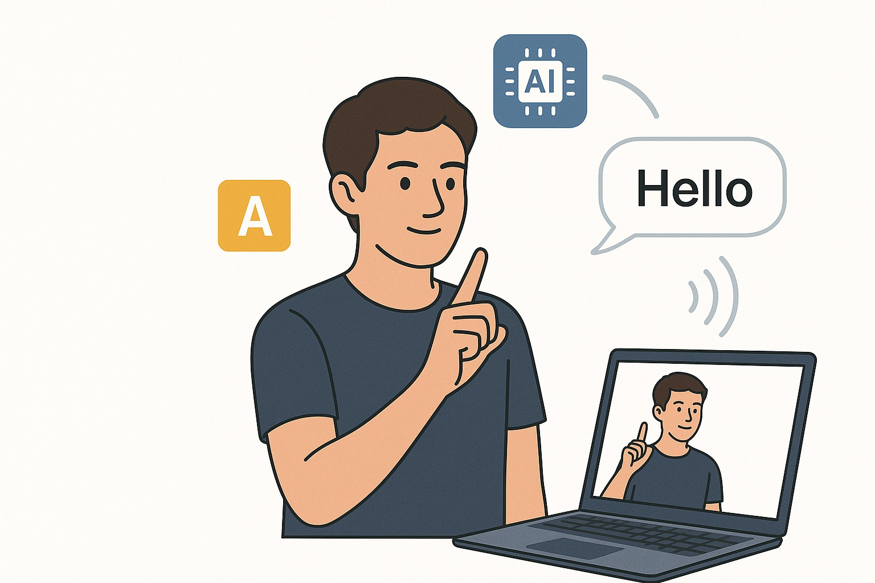
VALIDATION & TESTING

Slide 29
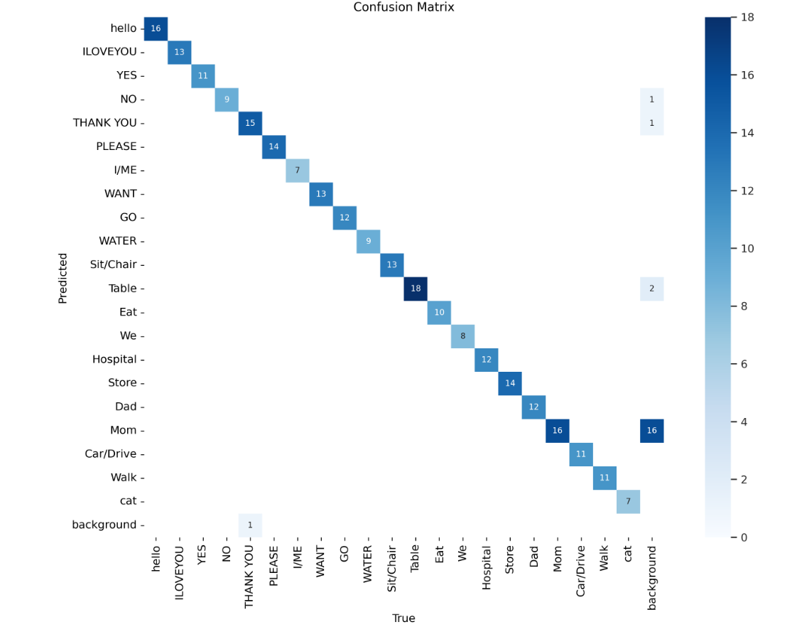
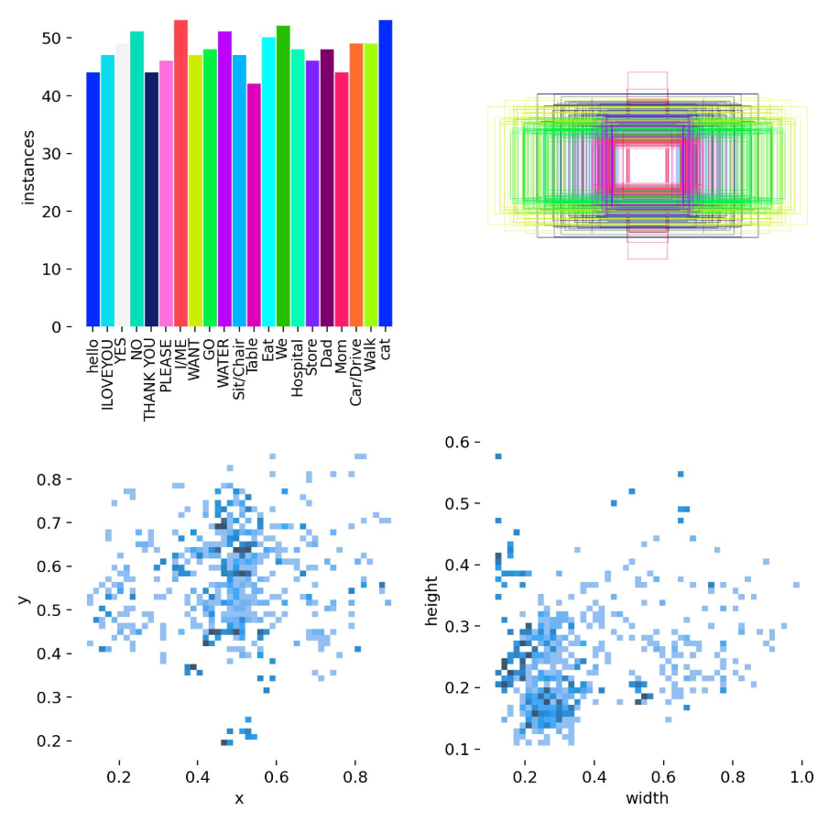

Slide 30
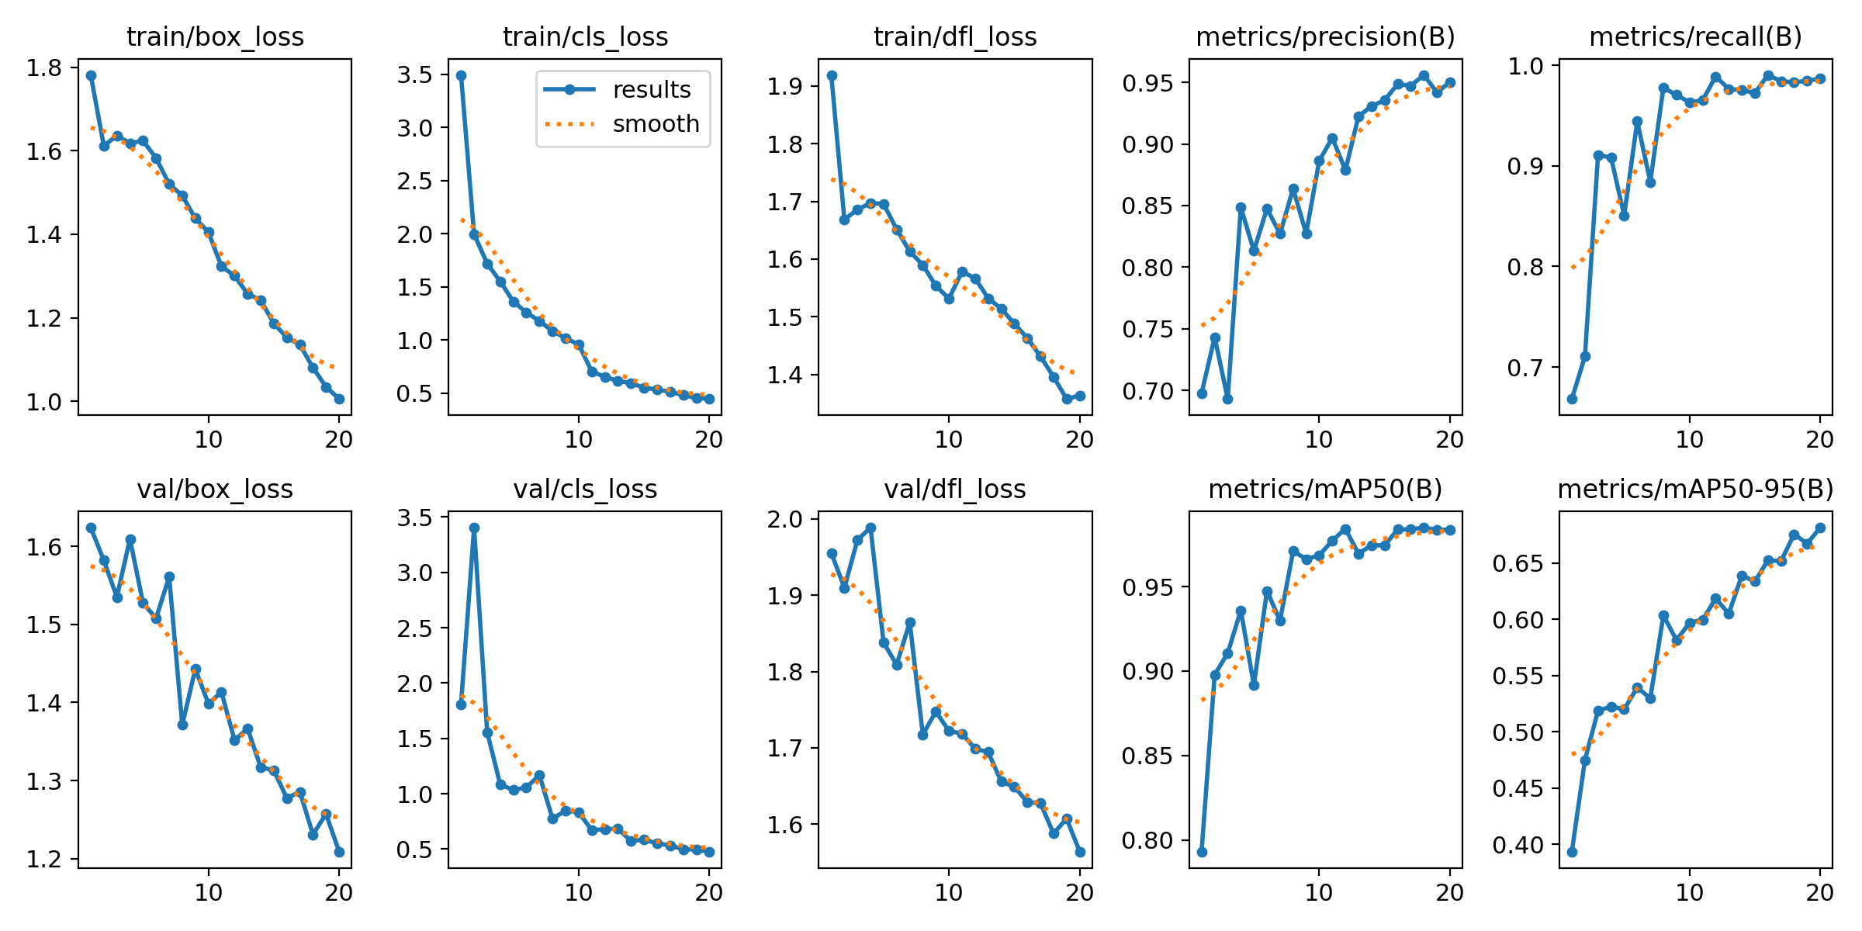

Slide 31
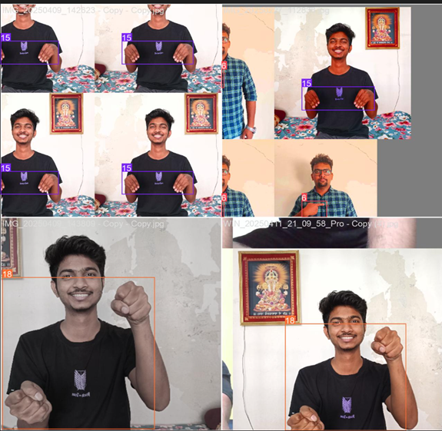

Slide 32
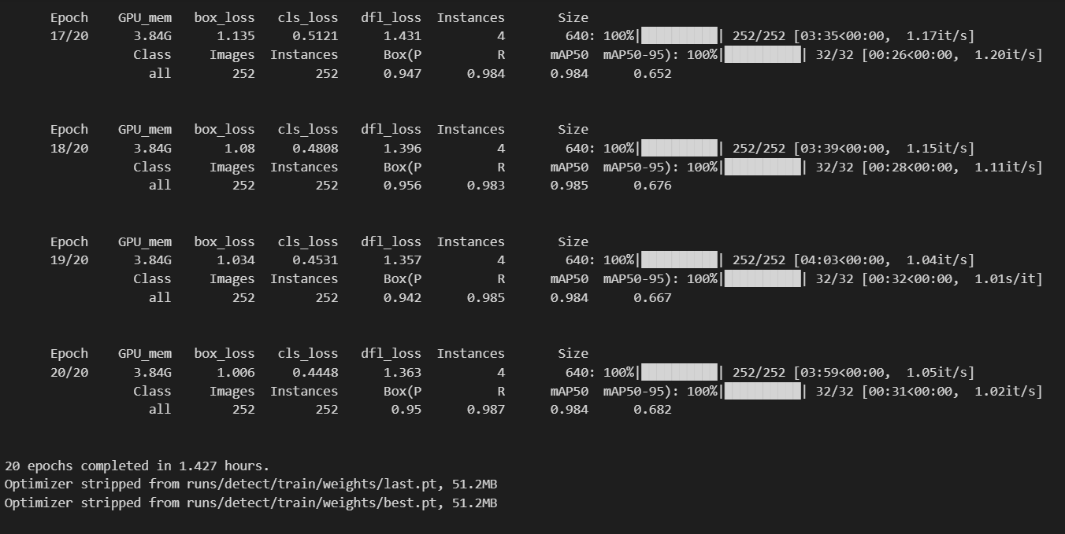
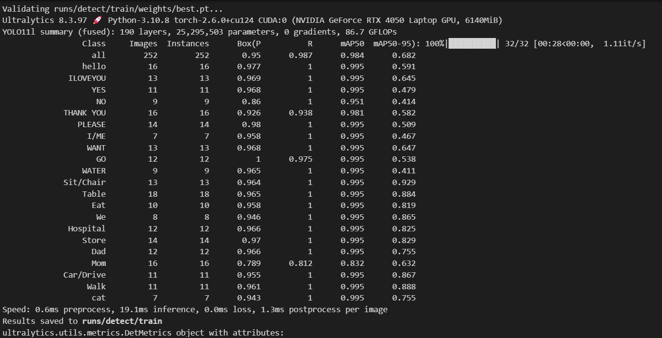

Slide 33
Confusion Matrix & Class Distribution Analysis Confusion Matrix (Top-left in first image): The confusion matrix shows how well the model is distinguishing between different American Sign Language (ASL) classes. A perfect classification would show all values along the diagonal, which is largely achieved here. Misclassifications are minimal, indicating high model accuracy. Class Distribution (Top-right bar chart): Each class (e.g., HELLO, THANK YOU, ILOVEYOU) has a near-uniform distribution (~50 images per class), which contributes to balanced training and reduced bias toward any single class. Bounding Box Analysis: The right-hand side contains plots showing object position (x, y) and dimensions (width, height) distributions. This visualization ensures bounding boxes are well spread across the image space and of varied sizes—important for robust model learning. 2. Model Performance Metrics Training and Validation Losses (Second image - Left): train/box_loss, train/cls_loss, and train/dfl_loss all decrease steadily over epochs. val/box_loss, val/cls_loss, and val/dfl_loss follow a similar trend, confirming that the model is learning effectively without overfitting. Accuracy Metrics: Precision and Recall approach ~0.98–1.0, reflecting a high rate of correct detections and low false positives/negatives. mAP@0.5 and mAP@0.5:0.95 (Mean Average Precision): These scores measure the model's detection quality across multiple IoU thresholds, with scores close to or above 0.95 indicating excellent performance.

Slide 34
Sample Inference Images: The right section shows real predictions made by the trained model. Bounding boxes with class labels and confidence scores demonstrate real-time performance and accuracy. 3. Training Summary & Model Output Training Summary (YOLOv11) (Third image): Trained for 20 epochs using Ultralytics YOLOv11 on a dataset with 252 images. Model training was completed in 1.42 hours using a NVIDIA RTX 4050 GPU. Final model saved as best.pt and last.pt for future inference or deployment. Final Metrics: Overall mAP@0.5: 0.984 mAP@0.5:0.95: 0.682 Model shows consistent high performance across all classes. Most classes (e.g., HELLO, ILOVEYOU, THANK YOU) have precision and recall nearing 1.0, indicating strong classification reliability.

Slide 35
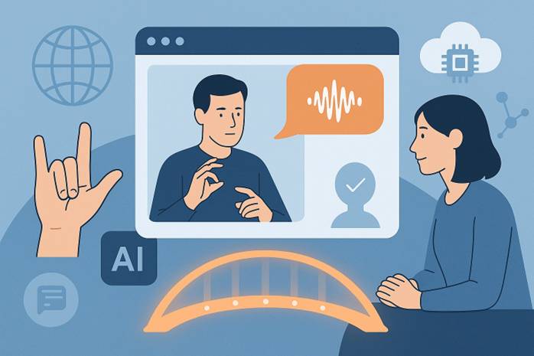
OUTPUTS

Slide 36
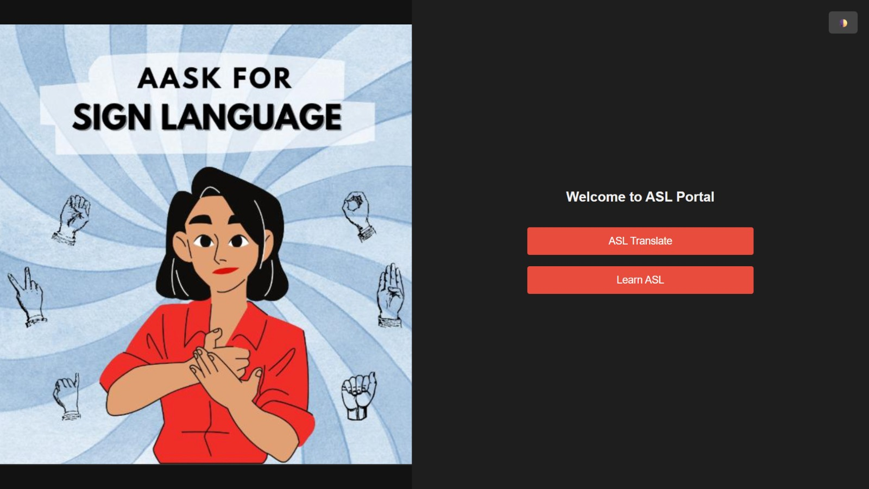

Slide 37
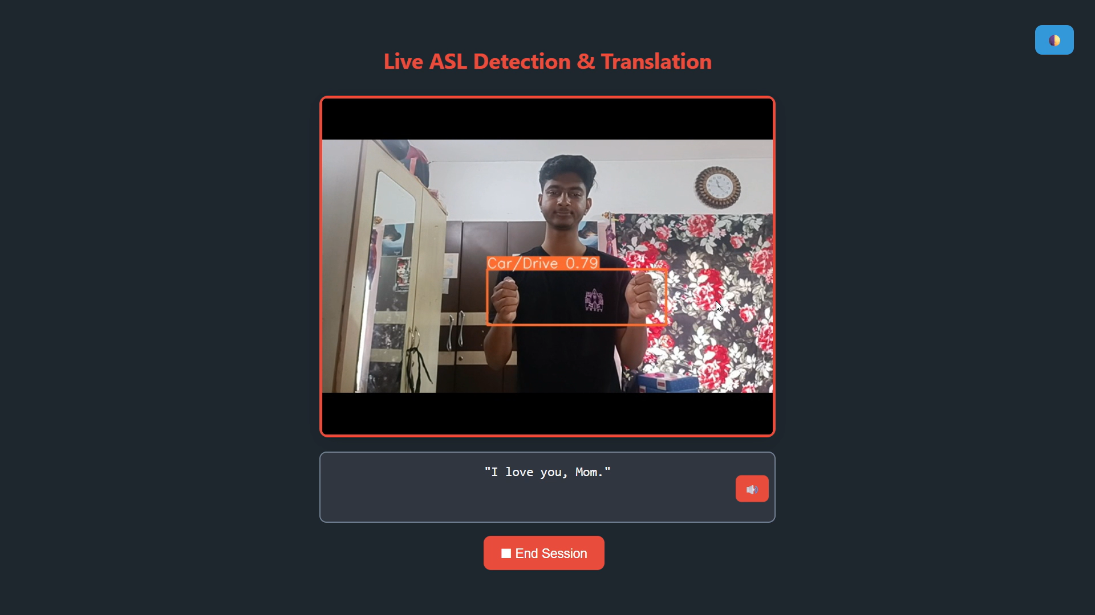

Slide 38
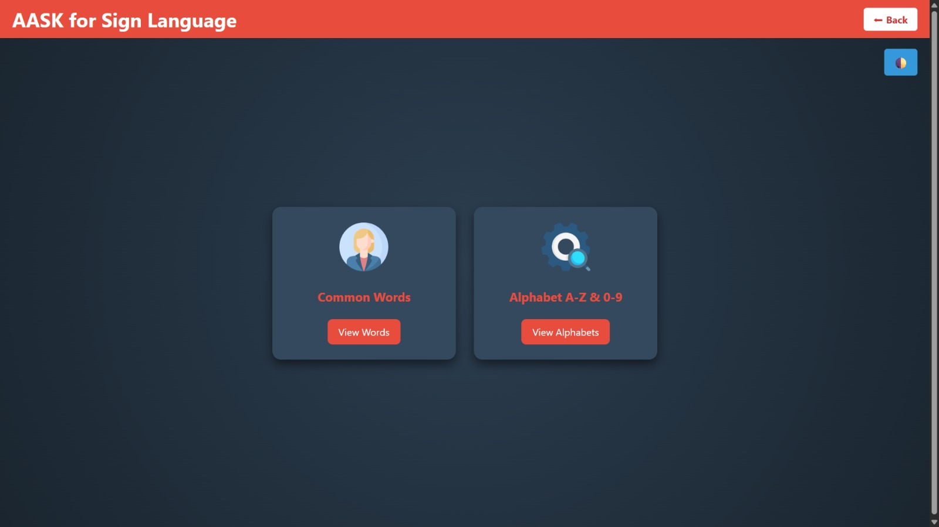
LEARN ASL

Slide 39
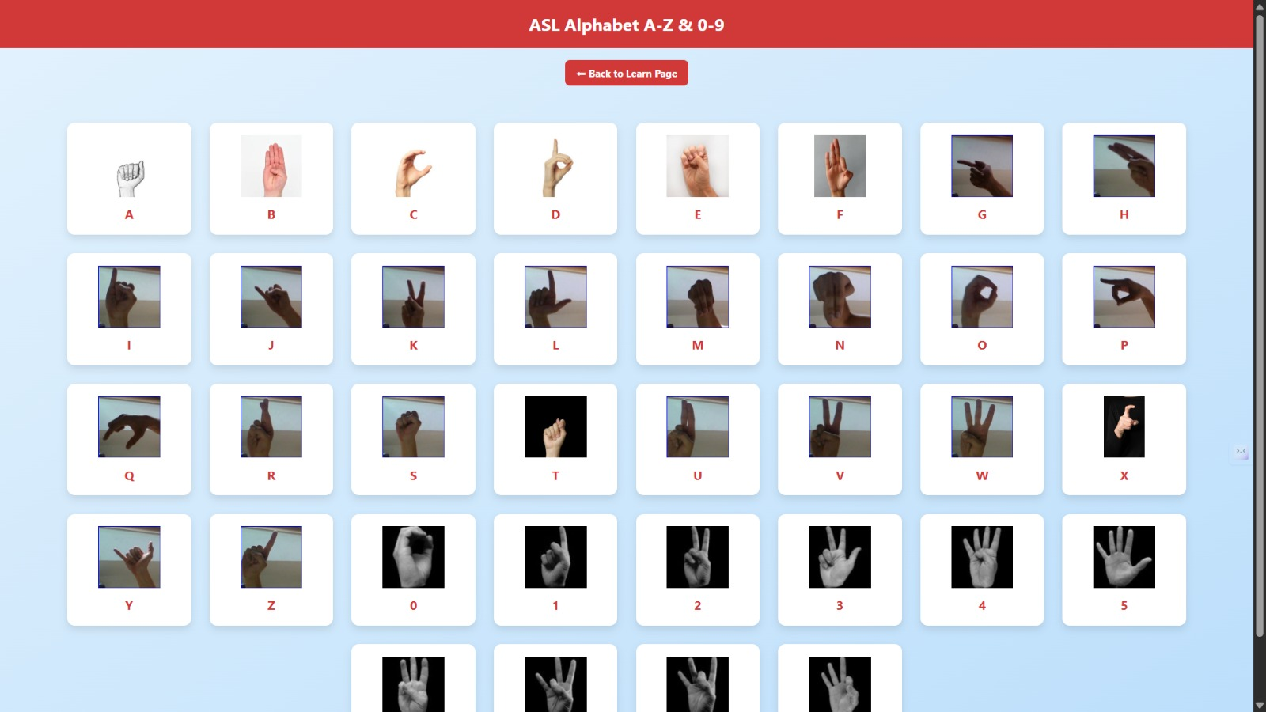

Slide 41
Conclusion
The ASL detection model trained using YOLOv11 shows excellent performance in both classification and localization tasks. Balanced dataset labeling, effective bounding box augmentation, and high-accuracy metrics confirm the model's readiness for real-time sign language recognition applications.

Slide 42

Any Questions?

